Slide 1

SUMMER OLYMPICS
(1980 - 2012)
SUBMITTED BY - SANYA DUBEY

Slide 2
DATA SOURCE
THE DATA IS GATHERED FROM KAGGLE.
LINK TO THE DASHBOARD : https://drive.google.com/drive/u/0/folders/1HgJZd81QFLhbg1j3zZICSbQhT5hrmRpo

Slide 3
PROBLEM STATEMENT
1. Total Medal types (Gold,Silver,Bronze) count in each olympic year.
2. Top 5 countries over the olympic history.
3. Top 5 countries per olympic year.
4. Gender ratio by overall olympic years.
5. Gender ratio respective of medals won by overall olympic years.
6. Ratio of males and females per olympic year.
7. Ratio of medals won by males and females respectively per olympic year.
8. Trends of country participation.
9. Total count of sports per olympic year
10. Total count of athletes per olympic year.
11. Top 5 athletes.

Slide 4
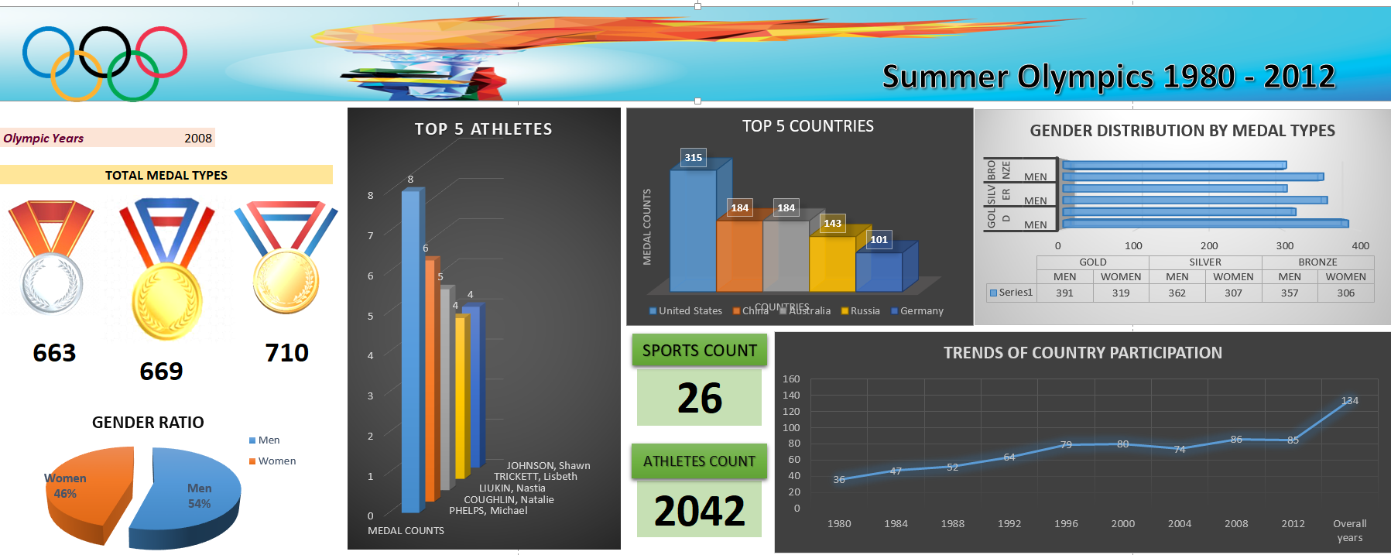

Slide 5
Conclusion
The olympics is divided into two seasonally themed halves. the summer olympics includes a myriad of fair weather sports, from track and field to swimming, gymnastics, and basketball.
When it comes to overall Olympic success, it’s the United States and then everyone else.
The United States have won a whopping total of 2,522 medals at the Summer Olympics, at an average of more than 93 medals per Games. It is streets ahead of the closest challenger, which is the Soviet Union, with 1,010 medals at an average of just over 112 medals per Games. The nearest active challenger to the US is Great Britain with 851 medals at an average of just over 30 per appearance at the Summer Games. France follow with 716 at an average of just over 25 medals per Games, then Germany with 615 medals won.
Women did not make up more than 10 percent of participants until 1952; that ratio has crept up since then. Women were not allowed to compete in every sport until 2012, and it was not until 2014 that the I.O.C.’s planning agenda included working “to achieve 50 percent female participation in the Olympic Games.” It is now that the participation of women are actively seen.

